Slide 1

The Organization of Tomorrow

Slide 2

Presentation Outline
Virtual organizations
Virtual vs. Traditional
Telecommuting
Web-based business models

Slide 3
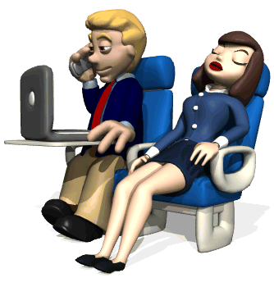
What is Virtual Organization
Computer networks
Software
Outsource
A virtual company is where work is performed outside of the headquarters

Slide 4
What is a Virtual Organization
It excludes:
  Factories
  Headquarter Building
  Distribution System
  Retail store
  Numerous Wages
It includes:
  Small IT & Management teams
  Headquarters is managing center for all actions
  Expensive networks
A virtual company is where work is performed outside of the headquarter

Slide 5
Why is there a future in Virtual Organizations?
You don't have to be multimillion company to be virtual!
Flexibility
More free money
Innovations
When something goes wrong...?!?

Slide 6
Information Technology in business environment
Collaboration software lets small companies act bigger

Slide 7
Traditional Versus Virtual
Supplier
Company
Retailer
Finance
Production
R&D
Supplier
Company
Retailer
Marketing
Purchasing
Distribution

Slide 8

IT requirements by a Virtual Organization
To be efficient it must use most developed and widely implemented technological tools:
    Communication tools (email,teleconferencing...)
    Intranet
    Internet
    GroupWare
    Databases

Slide 9
Virtual worker
You are hired, now go home!

Slide 10

Skills needed for Telecommuting
Multiple communication skills
Decision making confidence
Accountability

Slide 11
The benefits of telecommuting
Benefits to the employee
Less stress (no driving, no office pressure)
Ability to go to school while working (distance learning)
Improved family life (fewer family conflicts)
Opportunity to make more money (more free time)
Money saved on lunches, clothes, gas, car maintenance
Employment opportunities for housebound people (single parents of children, handicapped)

Slide 12

The benefits of telecommuting
Benefits to the organization
Increased productivity (15-50%)
Reduced real estate (or rent) cost
Ability to tap remote labor pool-Staffing flexibility
Less paperwork
Less absenteeism
Fewer labor costs
Better interaction of employees and suppliers

Slide 13
The benefits of telecommuting
Benefits to the society
Less air pollution
Less use of fossil fuels
Fewer traffic problems and car accidents
More business for suburbs and rural areas

Slide 14
Web-based business models
Merchant model – selling products wholesale and retail through the Web, e-tailing (Amazon.com,Dell.com,IBM.com)
Brokerage-Auction – bringing buyers and sellers together to make transactions (CashDirect.com,Freemarkets.com)
Advertising – providing information or services while generating revenue from advertising (Yahoo.com)
Subscription – selling access to the site (Wall Street Journal, Harvard Business Review)
Infomediary – collecting information on users and selling to other business (ePinions.com)
Community – supporting site by donations from community of users (National Public Radio Online)

